Slide 1
Module 4: Getting to Discharge

Slide 2
Pro Bono Bankruptcy Training Program Material
This presentation has been prepared by the National Consumer Law Center, Inc. (NCLC). For more information about NCLC, go to www.consumerlaw.org.
Copyright © 2015 by National Consumer Law Center, Inc. National Consumer Law Center and NCLC are registered trademarks of National Consumer Law Center, Inc. All Rights Reserved

Slide 3
From Filing to Discharge
Completing and amending schedules and required forms
Representing the debtor at the meeting of creditors
Complying with document production requirements
Dealing with secured debt
Satisfying the financial education course requirement
Obtaining and enforcing the discharge
Notes:
Overview of what this Module will cover.

Slide 4
First Steps After the Case is Filed

Slide 5
File Outstanding Documents
Initial required documents that were not filed with the petition must be filed within 14 days after the petition date
Use a checklist and calendar/tickler system
Send a letter to the debtor reminding of any additional information needed
Set an appointment to go over the final documents
If additional time is needed, file a motion for extension of time – courts will often grant an additional 7 to 14 days for cause shown
Bankruptcy Rule 1007(c)
Notes:
Module 4 - 1.1
Although covered in Module 3, trainers may want to discuss here the “automatic dismissal” of a case under section 521(i) that may occur if the information and documents required by section 521(a)(1) are not filed within 45 days after the petition date.
If there are any doubts about what may have been filed, check the court docket.

Slide 6
Counseling Certification
Pre-bankruptcy counseling certification: if not filed with the petition, it must be filed within 14 days
Deferral of counseling: In rare case where debtor has requested deferral based on exigent circumstances, attorney must verify whether motion was granted or whether court will require a hearing:
If the request is granted, debtor must complete briefing within 30 days after the petition date
The court may, for cause, extend this period by giving the debtor an additional 15 days 11 U.S.C. § 109(h)(3)(B)
The certification from an approved agency will need to be filed once the briefing has been completed
Notes:
Module 4 - 1.1.1
The credit counseling briefing must occur before the bankruptcy is filed. The 14-day postpetition period is only for the filing of certification form from the approved agency that provided the briefing. If more time is needed to file the certification, a motion for extension of time under Bankruptcy Rule 1007(c) must be filed before the 14-day period expires.

Slide 7
Filing Fee Issues
Request for waiver: Follow up to find out whether the motion was granted
Prepare debtor if hearing is required by the court
If waiver request is denied, the court will usually set a schedule for payment in installments
Request to pay in installments: Follow up to make sure the debtor understands when payments are due and how they must be made:
Remind debtor that failure will result in dismissal of the case!
Most courts will not take personal checks or credit cards from the debtor – they require payment by cash, money order, or a cashier's check
Notes:
Module 4 - 1.2
Discuss whether waiver requests are routinely granted in your district without a hearing, if hearings are routinely held, if particular issues (e.g, exempting a large tax refund or garnished wages you intend to get back) are likely to raise the court’s eyebrow or require further explanation.

Slide 8
Motion to Impose or Extend Stay
WARNING for repeat filers: is the automatic stay limited?
One prior case dismissed in past year:
automatic stay will only last 30 days unless extended
file a motion to extend the stay within 30 days after filing
hearing must be held within 30-day period, so file motion asap
Two prior cases dismissed in past year:
automatic stay does not take effect upon filing!
file a motion to impose the stay
Debtor must show case filed in good faith, usually by showing that circumstances have changed since prior case
Notes:
Module 4 - 1.3
Where there has been one prior dismissal, some courts take the position that the automatic stay continues to apply in the later case as to property of the estate, such as the debtor’s home, because the stay terminates only “with respect to the debtor.” These courts may take the view that a motion to extend the stay is therefore unnecessary. Discuss any local case law and practice on this point.

Slide 9
Amendments to Schedules
Debtors often forget things or make mistakes in the original schedules
Bankruptcy Rule 1009 provides that the debtor may amend the initial papers as a matter of course at any time before the case is closed
Simply file the amended document verified by the debtor
Additional $31 filing fee amendment adding creditors (unless filing fee waived)
Notes:
Module 4 - 1.4
A $31 filing fee is charged for filing an amendment to the debtor’s schedules or mailing list of creditors. No filing fee is required if the amendment is simply to change the address of a creditor or an attorney for a creditor listed on the schedules, or to add the name and address of an attorney for a listed creditor.
The Bankruptcy Court Miscellaneous Fee Schedule is available at: http://www.uscourts.gov/FormsAndFees/Fees/BankruptcyCourtMiscellaneousFeeSchedule.asp

Slide 10
Amendments to Schedules
The debtor must give notice of the amendment to the trustee and to any entity affected by the amendment
for amendment to debtor’s exemptions, notice should be sent to all creditors
if amendment involves addition of creditors on Schedules D through F, notice should be sent to creditors added (and any other creditors that may be affected)
Notes:
Module 4 - 1.4

Slide 11
Providing Tax Returns
Tax returns to trustee: at least 7 days before the date first set for meeting of creditors, debtor must provide to the trustee a copy of most recent federal income tax return
return should be for tax year ending immediately before commencement of case and for which a return was filed
no need to provide tax return if debtor was not required under applicable law to file a return for most recent tax year (See IRS Form 9542)
debtor may give the trustee a written statement that such tax documentation does not exist
debtor is given option to provide copy of return or transcript of the return
11 U.S.C. § 521(e)(2)(A)(i); Bankruptcy Rule 4002(b)(3)
Notes:
Module 4 - 1.5.1

Slide 12
Providing Tax Returns
Tax returns to creditor: if a creditor makes a timely request for a tax return or transcript that is to be provided to the trustee, debtor must give copy to creditor at same time provided to trustee
creditor’s request must be made at least 14 days before the date first set for the meeting of creditors
such requests generally are not made in routine cases
11 U.S.C. § 521(e)(2)(A)(II); Bankruptcy Rule 4002(b)(3)
Notes:
Module 4 - 1.5.2

Slide 13
Providing Tax Returns
Tax return filed with court: if a creditor or interested party requests, the debtor must file with the court a copy of a tax return filed with the IRS during the bankruptcy case
covers returns for tax years ending during the case or for a tax year ending in the three years before the petition
such requests generally are not made in routine cases
11 U.S.C. § 521(f)(1)-(3); Bankruptcy Rule 4002(b)(3)-(5)
Notes:
Module 4 - 1.5.3

Slide 14
Privacy Issues
Compliance with the tax return requirements should be done in a manner that preserves the debtor’s privacy
Bankruptcy Rule 4002(b)(5) provides that tax returns or transcripts provided to the trustee, or to creditors who request them, are subject to the procedures for safeguarding the confidentiality of tax information set by the Director of Admin. Office of U.S. Courts
Director’s Guidance for Protection of Tax Information provides that interested parties seeking returns under section 521(f) must file a motion and show cause
Notes:
Module 4 - 1.5.5
The Director’s Guidance for Protection of Tax Information provides that for requests for tax information under section 521(f) by a United States trustee, trustee, creditor or other party in interest, a motion must be filed with the court that includes a statement showing a demonstrated need for the information and the inability to get it in any other manner.. The procedures recommend that the order granting a motion for provision of tax information should include language advising the movant that the tax information obtained is confidential and that sanctions may be imposed for the improper use, disclosure, or dissemination of the tax information.
See Judicial Conference of the United States Bankruptcy Case Policies, § 830, Guidance for Protection of Tax Information, available at: http://www.uscourts.gov/rules-policies/judiciary-policies/bankruptcy-case-policies.

Slide 15
Privacy Issues
The Director’s Guidance for Protection of Tax Information requires that tax information provided under § 521 be redacted to show only:
(1) the last four digits of Social Security and ITIN numbers,
(2) the initials and not the names of minor children,
(3) the year of any date of birth, and
(4) the last four digits of any financial account number.
The procedures do not permit tax returns filed with the court to be accessible to the public
Notes:
Module 4 - 1.5.5

Slide 16
Obtaining Returns or Transcripts
Clients can download tax transcripts from the IRS website at: http://www.irs.gov/Individuals/Get-Transcriptcan
They can also request transcripts on-line at the IRS website or by calling the IRS at (800) 908-9946, which initiates an automatic process that results in the transcript arriving by mail in about five to ten business days at the client’s address found on the return
Transcripts can also be obtained by the debtor by using Form 4506-T or 4506T-EZ. This process usually takes from one to two weeks
The IRS also has procedures for attorneys to obtain transcripts on behalf of the debtor
Notes:
Module 4 - 1.5.4
The IRS has changed the procedure for obtaining transcripts several times in recent years. Trainers should attempt to provide the most recent information.

Slide 17
Filing the Statement of Intent
In chapter 7 cases the debtor must prepare and file a statement of intention (Official Form 108) regarding property securing debts and leased personal property
The statement must be filed and served on the trustee and all creditors named in the statement:
within 30 days after the petition date, or
on or before the date of the meeting of creditors, whichever is earlier
The court may extend the deadline for cause
11 U.S.C. § 521(a)(2); Bankruptcy Rule 1007(b)(2)
Notes:
Module 4 - 1.6
Options the debtor may select on the Statement of Intention for dealing with secured debt are covered later in this Module.

Slide 18
Dealing with Utility Deposits
To ensure that utility service is continued, find out whether the debtor will need to pay a deposit within the 20-day period following the filing of the petition
Creditors often require a deposit equal to two times the average monthly bill
If required by the creditor/utility, this “adequate assurance” payment must be made within 20 days after filing the petition
11 U.S.C.§ 366(b)
Notes:
Module 4 - 1.7
Trainers should discuss local practice because some utility companies do not request a security deposit, while others may request deposits based on guidelines for nonbankruptcy customers set by the local public utilities commission. It may be worth contesting the appropriate amount for “adequate assurance of future payment” if an excessive deposit amount is demanded. If the parties cannot agree on a deposit amount (or other adequate assurance), the court may order a “reasonable modification” of the amount.

Slide 19
Meeting of Creditors

Slide 20
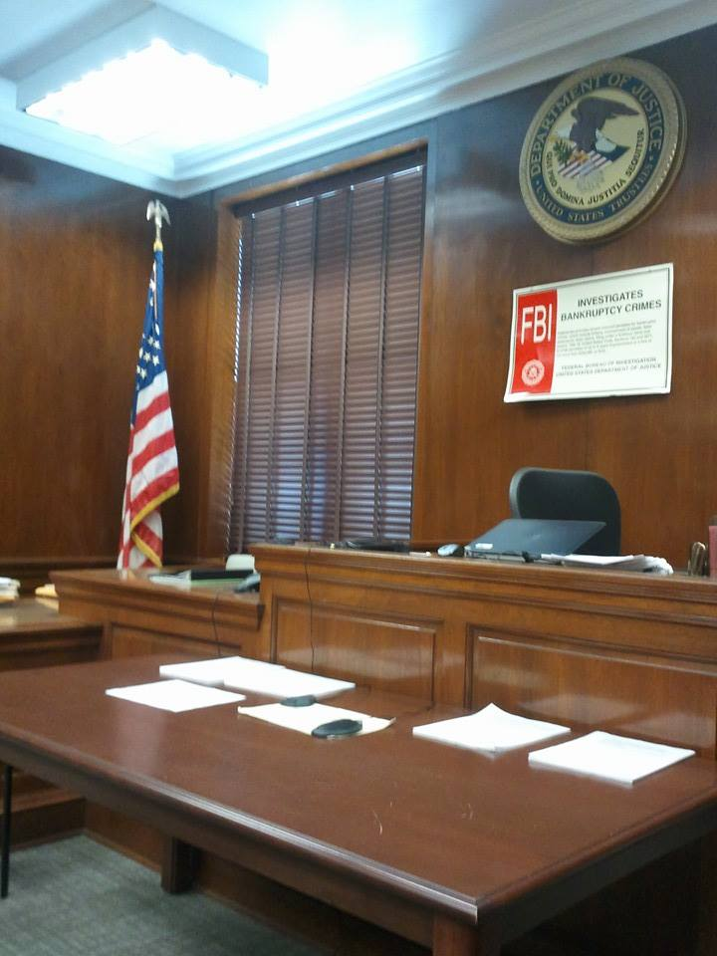
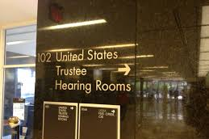
Meeting of Creditors
Notes:
Module 4 - 2.1 and 2.3.

Slide 21
Preparing for the Meeting
Send the debtor a letter right away informing them of location, date and time of the meeting and reminding them of what they will need to bring
Explain what to expect:
The trustee will ask questions under oath
Meeting is tape recorded
Trustee is checking to see if all the information filed is accurate and complete
If joint case, both debtors must attend
Usually no creditors attend the meeting
Notes:
Module 4 - Section 2.1
Trainers should discuss where the section 341 meetings are typically held in the district.
The client should be advised that the trustee is not there to assist the debtor despite how helpful a trustee appears to be at the 341(a) hearing, and that the Trustee can not provide the client with legal advice about the client's case.
In the letter sent to the client about the importance of attending the meeting of creditors, you should also remind the debtor about the need to complete the financial education course and the deadline for doing so.
If the debtor will need translation services, as discussed in Module 4 – 2.3, counsel should contact the trustee assigned to the case before the meeting.

Slide 22
Typical Questions at the Meeting
“Have you read and do you understand the Bankruptcy Information Sheet?”
“Here is a copy of your petition. Is that your signature on the petition?”
“Did you disclose all of your assets and all of your debts?”
“Have you transferred any property in the last 2 years?”
“Are you working?”
“Do you have the right to sue anyone? From a slip and fall in the grocery store, car accident, employment discrimination, etc?”
“How much do you think your house is worth? Based on what?”
Notes:
Module 4 - Section 2.3
In chapter 7 cases, the trustee must orally examine the debtor to ensure that the debtor is aware of certain bankruptcy matters. 11 U.S.C. § 341(d). Trustees typically satisfy this requirement by giving out the information in written form, the “Bankruptcy Information Sheet,” and then asking whether the debtor has read it. Counsel should give a copy of the handout to clients before the meeting and review it with them. Versions of the handout are available in Spanish and a number of other languages, on the United States Trustee Program’s website at: http://www.justice.gov/ust/eo/ust_org/bky-info/.

Slide 23
Document Production
Debtor must bring the following to the meeting:
Picture ID (such as a driver’s license or state-issued photo ID)
Proof of debtor’s Social Security number, or written statement that documentation does not exist
Unless trustee or U. S. trustee instructs otherwise, statements for each of the debtor’s depository and investment accounts (such as checking, savings, money market, mutual fund, and brokerage accounts) for time period that includes petition date
Proof of current income such as most recent pay stub
Documentation of any additional expenses claimed on Official Form 22 under the means test, when required by section 707(b)(2)(A) or (B)
Bankruptcy Rule 4002(b)
Notes:
Module 4 - 2.2
For the last three bulleted items dealing with financial information, Bankruptcy Rule 4002(b)(2) provides that if the documentation does not exist or is not in the debtor’s possession, the debtor may provide a written statement to that effect. This statement should be prepared before the meeting of creditors and provided to the trustee at the meeting.
Explain local practice in your district if any additional information is requested.

Slide 24
Dealing with Secured Debt

Slide 25
Statement of Intention – Follow Up
Debtor must perform stated intention within 30 days after first date set for meeting of creditors
Failure to timely perform may result in termination of the automatic stay as to the personal property subject to the statement
Secured debt: Retain or Surrender?
If retaining, debtor will:
Reaffirm the debt;
Redeem the property;
Exempt the property and avoid lien; or
“Other”: e.g., “retain and pay” (home mortgage, if current).
Leased personal property: Assume the lease?
Creditor may condition assumption on curing any pre-petition default
11 U.S.C. §§ 362(h); 521(a)(2)(B); 521(a)(6)
Notes:
Module 4 – 3.1
The court may extend the 30-day deadline for cause.
If the creditor has a purchase money security interest in personal property, section 521(a)(6) suggests that the debtor may have forty-five days after the meeting of creditors to perform the intention.
Failure to perform the debtor’s stated intention may result in termination of the automatic stay, but only as to personal property subject to the statement. 11 U.S.C. §§ 362(h) and 521(a)(6).
The “retain and keep paying” option is discussed n a later slide.

Slide 26
Reaffirmation
Debtor agrees to remove debt from the discharge
Debtor remains personally liable – may be sued if property repossessed and deficiency
To be enforceable, the reaffirmation agreement:
must be signed and filed with court before discharge is entered
court must find that reaffirmation will not pose an undue hardship
attorney may certify no undue hardship; otherwise court will hold a hearing
Reaffirmation agreement may be canceled any time before entry of discharge order OR sixty days after agreement is filed with court, whichever occurs later. No reason is required.
11 U.S.C. § 524(c)
Notes:
Module 4 - 3.1.1
Explain your experiences with reaffirmation agreements.
Explain that should request the agreement from the creditor early in the case; some creditors will not agree to let a debtor reaffirm.

Slide 27
Reaffirmation
Usually NOT a good idea if:
Amount owed exceeds value of collateral and creditor refuses to reaffirm at a lower amount
Debtor has defenses to owing the debt
Debt is a high-cost loan or contains unfavorable credit terms and creditor refuses to negotiate more reasonable terms
Debtor has no interest in keeping the collateral or has no ability to maintain payments
Debtor is behind on payments and creditor refuses to include as part of reaffirmation an affordable payment plan to cure the default
Notes:
Module 4 - 3.1.1

Slide 28
Reaffirmation
May be a good idea if:
Creditor gives something valuable in return, such as agreeing to let debtor get caught up in a manageable way, or reducing secured debt to value of property
Debtor wants to keep needed collateral, such as motor vehicle, and creditor or court will not permit debtor to keep it without reaffirming
Some creditors will allow debtor to retain collateral and keep paying even if no reaffirmation agreement is signed
It is generally never a good idea to reaffirm a credit card debt, even if credit card is secured or the creditor offers to keep the account open based on reaffirmation
Notes:
Module 4 - 3.1.1

Slide 29
Should the debtor reaffirm…?
?
Maybe (most common; consider the risks and other options)
?
Probably not
No
Notes:
Module 4 – 3.1.1 and 3.1.2
Consider the risk of a deficiency if debtor later defaults on payments; does debtor owe more than the car is worth? Can debtor get another car, either on cash or credit? Can debtor redeem the car (discussed later in the slides).
Home Mortgage, Module 4 – 3.1.3. Usually there is no need to reaffirm the mortgage on the debtor’s principal residence, because the right to “retain and keep paying” is recognized in section 524(j) (discussed later in the slides). If debtor later defaults, the potential deficiency could be huge. However, if debtor does not reaffirm, she may not get the benefit of monthly statements (although most creditors seem to keep sending them); may not have payments reported to credit bureaus, which could make refinancing difficult; and may have difficulty getting a loan modification (although program rules say a mod should still be permitted).
Credit card – Module 4 – 3.1.4. It is very hard to think of a situation where reaffirming a credit card debt would be a good idea. Some creditors may offer the debtor continuing use of the card after bankruptcy if they reaffirm – but it is generally no problem to get new credit cards after bankruptcy, and the cost of continuing liability generally outweighs the benefit of the access to credit.

Slide 30
Undue hardship?
If debtor’s attorney negotiates the reaffirmation, must sign a certification stating that:
debtor has been fully advised about consequences of the reaffirmation agreement
agreement is voluntary act of a fully informed debtor, and
agreement does not impose an “undue hardship” on the debtor or the debtor’s dependents. 11 U.S.C. § 524(c)(3)
If the debtor’s attorney does not sign the reaffirmation agreement (and debt not secured by real property), court must approve the reaffirmation 11 U.S.C. § 524(c)(6)
Notes:
Module 4 – 3.1.5
Discuss attorney certification and how this can put the debtor’s attorney in a tough spot, if client wants to reaffirm but attorney can’t in good faith certify no undue hardship. Discuss how this is handled locally by the court. Option of leaving it to the debtor to negotiate the reaffirmation on his/her own – then it will be up to the Court whether to approve or not. Most courts will expect debtor’s counsel to appear at the hearing on the reaffirmation even if counsel did not negotiate the agreement.

Slide 31
Undue hardship?
Debtor must sign a statement that debtor believes he/she can afford the payments, based on income and expenses listed in Schedules I and J
If I and J show insufficient income, presumption of undue hardship, and debtor must explain how he/she will pay
Court may disapprove the reaffirmation if presumption not rebutted
Notes:
Module 4 – 3.1.5
Can the debtor in fact afford the payments, based on the budget shown in Schedules I and J? Are Schedules I and J accurate, or should they be amended?

Slide 32
Retain and Keep Paying (without reaffirmation)
For mortgage on debtor’s principal residence, this option is recognized by section 524(j)
creditor permitted to seek and accept payments rather than enforce in rem rights, without violating the discharge injunction
For personal property secured loan: this option generally not available unless creditor allows it; might not be in creditor’s best interest to repossess the collateral if debtor keeps paying
If debtor later defaults on payments and the creditor repossesses the collateral, debtor will not be on the hook for any deficiency
Notes:
Module 4 - 3.1.2

Slide 33
Reaffirm a Home Mortgage?
Usually not a good idea
Option to retain and keep paying, § 524(j)
Benefits of NOT Reaffirming:
No liability for a deficiency if later default and foreclosure
Debtor should still be able to apply for a loan mod if needed
Benefits of Reaffirming:
Debtor may continue to receive mortgage statements
Payment information more likely to be reported on credit report, improving chances of refinancing later
Debtor may have better chance of getting a loan mod later (especially with FHA loans)
Notes:
Module 4 – 3.1.3
Give examples from your experiences.
Regarding mortgage statements after chapter 7 discharge/ no reaffirmation – a proposed rule under the federal Truth in Lending Act may change this by requiring that statements be provided even if debt is not reaffirmed.
Explain that FHA loans seem to pose the greatest problems for loan modifications after chapter 7 discharge/ no reaffirmation. However, FHA rules clearly state that homeowners are eligible for modification after a discharge. Whether a homeowner can benefit from an FHA “partial claim” (which may be part of the modification process) is less clear.

Slide 34
Redemption
Section 722 provides for a right of redemption - debtor may eliminate a creditor’s lien by paying the creditor the value of the collateral securing the lien
Redemption right available only:
to individual debtors in chapter 7 cases
for dischargeable consumer debts secured by tangible personal property that has been either:
exempted by the debtor, or
abandoned by the trustee
Notes:
Module 4 - 3.1.5
For property used for personal, family, or household purposes that are most often redeemed, section 506(a)(2) requires valuation to be based on replacement value given the property’s age and condition at the time the value is determined.

Slide 35
Redemption
Not available for real estate or intangible liquid assets
Valuation should be based on replacement value given the property’s age and condition at the time the value is determined
HUGE potential benefit if the secured claim greatly exceeds the value of the property
Debtor must be prepared to pay redemption amount in lump-sum payment (unless creditor agrees to installments)
Notes:
Module 4 - 3.1.5
An example of an “intangible liquid asset” would be an expected tort recovery; so if a company that finances litigation takes a security interest in an expected tort recovery, 722 redemption would not be available for this kind of asset.

Slide 36
Redemption: Example 1
Couch was purchased on credit (loan secured by the couch)
Balance owed on petition date = $1,250
Value of the couch = $250
Notes:
Module 4 - 3.1.5

Slide 37
Redemption: Example 1
Creditor has a secured claim for $250 and an unsecured claim for $1,000
Debtor may redeem the couch by paying $250 to the creditor
Debtor keeps the couch free and clear of the lien
Creditor’s unsecured claim for $1,000 is discharged
Notes:
Module 4 - 3.1.5

Slide 38
Redemption: Example 2
Debt Owed - $5,000
Value - $2,000
Debtor may redeem by paying $2,000; unsecured claim for $3,000 will be discharged.
Notes:
Module 4 - 3.1.5
Explain how redemption is usually handled in your district; may be worked out by agreement with the creditor.
If creditor doesn’t agree or doesn’t respond, debtor may file a motion to redeem (may be granted as unopposed; then just send the order and the payment to creditor).

Slide 39
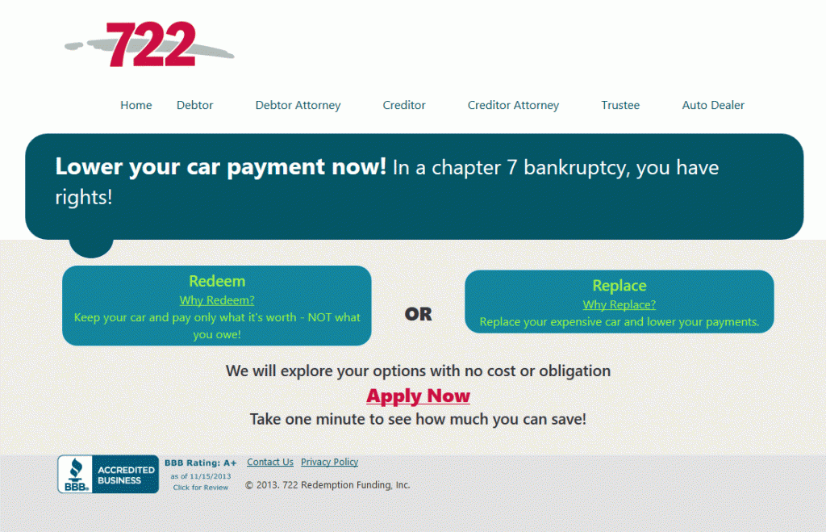
“722 Redemption Loans”
Notes:
Module 4 – 3.1.6
Redemption must be done through a lump-sum cash payment unless the creditor agrees otherwise (e.g, installments). Debtor may request additional time under section 521(a)(2)(B) to make the redemption payment. This could give the debtors additional time to save the necessary funds or obtain them a friend or family member.
The debtor also may be able to obtain financing of the full redemption amount, sometimes referred to as “722 loans.” These loans often carry very high interest rate; still could be worth it depending on all terms – they should be reviewed carefully.
Give examples from your experience.

Slide 40
Assuming Lease on Personal Property
Chapter 7 debtor may assume a personal property lease if it is not assumed by trustee - common with car leases
Step 1: Debtor must notify lessor in writing that intends to assume lease, which can be done on Statement of Intention
Step 2: Lessor may say willing to allow assumption and may condition assumption on cure of any outstanding default
Step 3: Debtor notifies the lessor in writing within 30 days after the first notice that the lease is assumed
debtor then assumes liability under lease and has right to retain property if payments are maintained
Court review and approval of the lease assumption are not required
11 U.S.C. § 365(p)
Notes:
Module 4 – 3.1.7
Section 365(p)(2)(B) provides that upon notification by the debtor of the lease assumption, liability under the lease is assumed by the debtor. However, some courts have held that assumption of a lease under section 365(p) does not constitute a reaffirmation of personal liability unless a formal reaffirmation agreement is executed in compliance with section 524.
If the debtor does not timely assume a personal property lease, section 365(p)(1) provides that the leased property is no longer property of the estate and the automatic stay is terminated as to that property.

Slide 41
Lien Avoidance
Debtor may avoid “fixing of a lien” on interest of debtor in property to the extent lien impairs an exemption
This applies to:
Judicial liens on any exempt property, including home, vehicle, household goods , garnished wages, etc.
except liens for domestic support obligation
Non-possessory, non-purchase money liens on certain personal property, including:
household furnishings, household goods , wearing apparel, jewelry, appliances, books, animals, crops, or musical instruments held primarily for personal, family, or household use of the debtor or debtor’s dependents;
implements, professional books, or tools of the trade
professionally prescribed health aids
11 U.S.C. § 522(f)
Notes:
Module 4 – 3.1.8
Lien avoidance – most commonly used to get rid of judgment liens on exempt home, car, personal property.
For example, Discover Card has sued your client, gotten a judgment, and taken a lien on the home – you may be able to avoid (remove) the lien.
Judicial lien avoidance may be an alternative to using the preference avoidance provision for wages garnished more than 90 days before the petition is filed. If under state law the debtor still retains a property interest in the wages on the petition date, and the debtor can claim the wages as exempt, the debtor may be able to avoid the lien under section 522(f) and recover the wages.
Non-purchase money, non-possessory liens on personal property are more rare these, though some finance companies and lenders still make small loans secured by the debtor’s household goods.
Car title loan could perhaps be avoided under 522(f) if the car is a tool of the trade (vehicles are not generally among the kinds of personal property where 522(f)(1)(B) can be used).

Slide 42
Lien Avoidance
Some math is required to determine if the lien can be avoided – if it “impairs an exemption”
A lien shall be considered to impair an exemption to the extent that the sum of –
the lien;
all other liens on the property; and
the amount of the exemption that the debtor could claim if there were no liens on the property;
exceeds the value that the debtor’s interest in the property would have in the absence of any liens
Courts have held that this formula is to be applied literally
11 U.S.C. § 522(f)(2)
Notes:
Module 4 – 3.1.8

Slide 43
Example
In re Jochum, 309 B.R. 327 (Bankr. E.D. Mo. 2004)
Homecomings First Deed of Trust $ 76,405
Concord Judicial Lien $ 16,305
Portfolio Judicial Lien $ 14,156
Homestead Exemption $ 8,000
TOTAL $114,866
Portfolio Judicial Lien
$ 14,156
Concord Judicial Lien
$ 16,305
Value of home
$100,000
Homecomings
First Mortgage
$76,405
Homestead Exemption $8,000
Notes:
Module 4 – 3.1.8
This example helps illustrate the lien avoidance formula as applied in an actual case. A different example is provided in Module 4 – 3.1.8.

Slide 44
Example
Homecomings First Deed of Trust $ 76,405
Concord Judicial Lien $ 16,305
Portfolio Judicial Lien $ 14,156
Homestead Exemption $ 8,000
TOTAL $114,866
Portfolio Judicial Lien:
Value debtor’s interest in property without any liens is $100,000.
Total of all liens plus debtor’s homestead exemption exceeds value of debtor’s interest by amount of $14,866.
Amount of Portfolio’s debt that is secured by its judicial lien ($14,156) is less than $14,866.
Portfolio lien therefore impairs debtor’s exemption and is void
Notes:
Module 4 – 3.1.8
Explain that in this example, a small amount of Concord’s lien could also be avoided ($710 worth – probably not worth the trouble; but the point is worth making that liens may be avoided “to the extent” they impair the exemption – so partial avoidance is possible).
Easiest way to think about the math: If the mortgage + any superior liens + the homestead exemption exceed the value of the house, then the lien in question impairs the exemption.
If there is some value over and above the total of mortgage + superior liens + exemption amount, then the lien in question may be partially avoidable.
If the mortgage + superior liens + homestead exemption + the lien in question is still less than the value of the home, the lien is fully secured without impairing the homestead exemption – so you’re not going to be able to avoid it.

Slide 45
Example
Homecomings First Deed of Trust $ 76,405
Concord Judicial Lien $ 16,305
Portfolio Judicial Lien $ 14,156
Homestead Exemption $ 8,000
TOTAL $114,866
Concord Judicial Lien:
Total of all remaining liens plus debtor’s homestead exemption exceeds value of the debtor’s interest by amount of $710.
Debtor may avoid the judicial lien of Concord in the amount of $710 and the lien remains in the amount of $15,595.

Slide 46
Lien Avoidance Process
The lien avoidance procedure is generally initiated by the filing of a motion- Bankruptcy Rule 4003(d)
Motions to avoid liens may be brought in both chapter 7 and chapter 13 cases
These motions are rarely contested; usually only when there is a dispute over the value of the property or the debtor’s claim of exemption
No time limit in the rules, but best to initiate the proceeding soon after the case is filed
Order avoiding the lien can be recorded in the appropriate real estate recording offices
Notes:
Module 4 – 3.1.8
If a lien is avoided in a chapter 13 case, the claim can be treated as an unsecured claim under the debtor’s plan.

Slide 47
What to do with a residential lease?
If debtor is current on rent and wishes to stay in premises, debtor should be advised to just keep paying
unexpired lease should be listed on Schedule G
debtor cannot assume residential lease in chapter 7 case
chapter 7 trustee could assume the lease, but rarely happens because no value for estate
if not assumed, lease is deemed “rejected” – but this does not mean that the lease is terminated
Notes:
Module 4 – 3.2
The treatment of residential leases depends highly on state law. Be prepared to discuss practice under state law.
Briefly discuss that this slide assumes that there has not been a prepetition judgment for possession entered against the debtor. If a judgment for possession has entered before the bankruptcy is filed, the automatic stay limitations would apply, as discussed in Module 1 – 1.5.3.

Slide 48
What to do with a residential lease?
If debtor behind on the rent when case filed:
past-due rent is a dischargeable unsecured debt listed on Schedule F
landlord cannot sue to recover back rent
but state law may permit landlord to bring eviction action based on a lease violation for nonpayment of rent, so if debtor wishes to stay in premises, may need to pay back rent
If the landlord doesn’t evict, a new month-to-month tenancy may be created under state law
Notes:
Module 4 – 3.2

Slide 49
Completing the Financial Management Course
To receive a discharge debtor must submit proof of completion of “instructional course concerning personal financial management” - 11 U.S.C. § 727(a)(11) and § 1328(g)
approved providers at www.justice.gov/ust
debtor must take the course after the petition is filed
Debtor must file Form 423 (certification of completion), unless course provider has filed notification with the court already – Bankruptcy Rule 1007(b)(7)
Deadline to file certification or notification of course completion:
in chapter 7: 60 days after first scheduled meeting of creditor
in chapter 13: before final plan payment or motion for hardship discharge
Notes:
Module 4 - 3.3
Chapter 7 debtors should be strongly urged to take the course before or soon after the meeting of creditors. If the certification of completion is not timely filed, the court will close the case without a discharge. Although courts will grant a motion to reopen a bankruptcy case to enter a discharge if the course is subsequently taken and certification submitted, that involves more work for debtor’s counsel and the debtor will need to pay a reopening fee ($245 for chapter 7 cases).
Most approved providers charge between $20 - $50 for the financial education course. Section 111(d)(1)(E) requires approved providers to provide the course without considering the consumer’s ability to pay. If the debtor cannot afford the fee, he or she should request that the agency provide the course free of charge or at a reduced fee. It may be helpful if the agency is informed that the debtor is being represented pro bono or if the court has approved the debtor’s filing fee waiver request, as most providers will waive the course fees for such debtors.
Similar to the prepetition credit counseling requirement discussed in Module 2, there are limited exceptions to the debtor education requirement for debtors who are (1) disabled or incapacitated, if that renders them unable to complete the course, (2) on active military duty in a combat zone, or (3) if the courses are not available in the debtor’s district. 11 U.S.C. §§ 727(a)(11), 1328(g) (incorporating 11 U.S.C. § 109(h)(4)).

Slide 50
Obtaining and Defending the Discharge

Slide 51
Obtaining the Discharge
Once debtor files all of required documents and attends meeting of creditors, getting discharge is pretty simple
In chapter 7 case, it is usually entered shortly after deadline for creditors to object to entry of discharge, which is 60 days after first date set for meeting of creditors
Court may hold a discharge hearing, but most elect not to
discharge hearing may be held if debtor indicates intent to reaffirm personal property
Court ordinarily will close the case shortly after discharge is entered
Notes:
Module 4 - 4.1
The deadline for objecting to discharge is set in Bankruptcy Rule 4004(a). The grounds for objecting to the debtor’s discharge are listed in section 727(a) and are discussed in Module 1.
Discuss under what circumstances, if any, the court will hold a discharge hearing.

Slide 52
Discharge of Student Loans
Usually, student loans are not dischargeable
Debtor may be able to discharge student loan debts if can show undue hardship - courts weigh three factors:
do the student loans prevent the debtor from maintaining a “minimal” standard of living?
is the hardship likely to continue for a “significant portion” of the repayment period?
has debtor made a good-faith effort to repay the loans (and to maximize income and limit expenses)?
Debtor must file an adversary proceeding to have the student loans discharged
No deadline for doing this, so a closed case may be reopened for this purpose
Notes:
Module 4 - 4.2
Most courts have adopted the three-part test set out in Brunner v. New York State Higher Ed. Servs. Corp., 831 F.2d 395 (2d Cir. 1987).
Discuss how your district evaluates undue hardship, experiences you have had dealing with the issue.

Slide 53
Revocation of Discharge
An interested party may request revocation of the discharge; must show that:
debtor obtained the discharge by fraud, and
this fraud was not known to the party until after the discharge was granted
Complaint seeking revocation of discharge must be filed within one year after the discharge was granted, though additional time may be allowed
11 U.S.C. §§ 727(d), (e), 1328(e)
Notes:
Module 4 - 4.3
Discuss that revocations of discharge are rare.

Slide 54
Debtor Audits
U.S. Trustee started random audits in 2006. At least one out of every 1,000 individual chapter 7 and chapter 13 cases is randomly selected for audit
there are other targeted audits of cases in which debtors have unusually high income or expenses
Audits attempt to determine the accuracy, veracity, and completeness of debtors’ petitions, schedules, and other information required by sections 521 and 1322
Debtor will be notified by letter early in the case if selected
attorney may give permission for auditor to communicate directly with debtor
debtor must provide requested documents to the audit firm within 21 days
Notes:
Module 4 – 4.4
A debtor’s discharge may be revoked if the debtor does not satisfactorily explain the failure to make available all documents or property requested by the audit firm. If the audit form finds that there were material misstatements and the debtor does not refute this or provide an adequate explanation, the United States Trustee may take appropriate civil action and, when appropriate, make a criminal referral to the United States Attorney.

Slide 55
Enforcing the Discharge
Debtor should be advised to contact you (or seek legal advice) if there are any attempts to collect discharged debts
Debtor should be advised about section 525 prohibition on discrimination by:
government agencies
private employers
student loan lenders
Violators of the section 524(a) discharge injunction may be held in contempt of court
actual damages, attorney’s fees and possibly punitive damages may be awarded
if case closed, motion to reopen should be filed to enforce the discharge (a reopening fee should not be charged in this instance)
Notes:
Module 4 - 4.5
Give examples re prohibition on discrimination, such as a public housing authority may not deny public housing assistance based on discharge of debt in bankruptcy.
A contempt proceeding may be initiated by the filing of a motion. Bankruptcy Rule 9020. If the case has been closed, the debtor first will need to file a motion to reopen the case. 11 U.S.C. § 350(b); Bankruptcy Rule 5010. A reopening fee is not charged by the court when a debtor files a motion to reopen “based upon an alleged violation of the terms of the discharge under 11 U.S.C. § 524.” See Bankruptcy Court Miscellaneous Fee Schedule.

Slide 56
Clearing up Credit Reports
Advise debtor to check credit reports 60-90 days after discharge to make sure creditors are properly reporting information about discharged debts as required by the Fair Credit Reporting Act (FCRA) - 15 U.S.C. §§ 1681-1681x
All debts discharged in the bankruptcy case should show a zero balance and be noted as having been included in the bankruptcy
Debtor may request reports at www.annualcreditreport.com (one free report per year)
If incorrect information is shown, debtor should notify both furnishers (creditors) and credit bureaus of the errors
If the error is not corrected, debtor may have a claim under the Fair Credit Reporting Act
Notes:
Module 4 - 4.6

