Slide 1
Module 3: Preparing the Bankruptcy Documents

Slide 2
Overview of Module 3
Required Documents
Getting the Case Filed
Preparing the Documents

Slide 3
Emergency Filing
Debtor can initiate case with a “skeletal filing,” including:
Voluntary Petition (Form 101)
Statement of Social Security number
Initial statement about prepetition eviction (Form 101A), if applicable
Creditor matrix (mailing list)
Application to waive filing fee/pay in installments, if full filing fee is not being paid at filing (Forms 103A or 103B)
Even in an emergency, ask client the basic questions first, so you can advise client about whether bankruptcy filing is in the client’s best interest (and check for prior filings)
Bankruptcy Rule 1007(c)
Notes:
Module 3 – 1.1; Module 2 – 4.5
Although an “emergency” filing is permitted by the Bankruptcy Rules, every effort should be made to ensure that the filing is appropriate. Counsel should also check whether the debtor has had any prior bankruptcy filings.
The credit counseling requirement must be completed before the bankruptcy fling, unless the debtor is seeking a waiver or deferral.
If a “skeletal filing” is made, counsel should impress upon the client the need to promptly provide any missing information, as the remaining schedules will need to be completed within 14 days after the filing of the petition.

Slide 4
Other Required Documents
Within 14 days after the case is filed, the Debtor must file:
Credit counseling certificate
Schedules (Forms 106A-106J)
Summary of the debtor’s assets and liabilities, and certain statistical information (Official Form 106Sum)
Declaration about the debtor’s schedules (Official Form 106Dec)
Statement of financial affairs (Official Form 107)
Disclosure of attorney fees paid or promised (Director’s Procedural Form B2030), and
Means test form(s) (Official Forms 122A-1, 122C-1, etc.)
Debtor may request an extension of time under Bankr. Rule 1007(c)
Notes:
Module 3 – 1.1

Slide 5
Other Required Documents
Within 14 days after the case is filed, the Debtor must file:
Payment advices (received by debtor from employer within 60 days of petition)
Plan in Chapter 13 case
Within 30 days after the case is filed, the Debtor must file:
Statement of Intention (Official Form 108) in Chapter 7 case
Debtor may request an extension of time under Bankr. Rule 1007(c)
Notes:
Module 3 – 1.1

Slide 6
Avoiding “Automatic” Dismissal
Under section 521(a)(1), certain documents must be filed no later than 45 days after the case is filed:
Creditor mailing List
Various information contained in Schedules A-J
Statement of financial affairs
Statement that 342(b) notice was provided
Payment advices for 60 days prior to filing
Notes:
Module 3 – 1.5

Slide 7
Getting the case filed
Electronic Case Filing (ECF)
Bankruptcy courts require electronic filing
Some courts will allow paper filing for attorneys who file an occasional case
Some courts require training for ECF access
Software programs
Software saves time by populating the forms with information
Another option is to use the fillable forms here: www.uscourts.gov/FormsAndFees/Forms/BankruptcyForms.aspx
Notes:
Module 3 – 2.1

Slide 8
Completing the forms

Slide 9
Tips: Basic Principles
All forms should be:
COMPLETE
Full disclosure required of all assets, liabilities, and other financial information
When appropriate check the box “no” or “none” rather than leave blank
When in doubt, list it!
ACCURATE
Provide correct and adequate property descriptions
Convey information as clearly as possible
When appropriate, supplement answers given with notes indicated by asterisks or on an attachment
CURRENT
Update all documents before filing
Promptly make corrections through amendments
Notes:
Module 3 – 3.1.1

Slide 10
Tips: Amending the Forms
Despite best efforts, mistakes and omissions do happen!
The debtor may amend the filed documents as a matter of course at any time before the case is closed. Bankruptcy Rule 1009.
Check box on forms “if this is an amended filing”
If you amend the schedule of creditors or mailing List, there is a $31 fee.
No fee if the amendment is simply to change the address of a creditor or an attorney listed on the schedules, or to add the name and address of an attorney for a listed creditor.
Notes:
Module 3 – 3.1.3; Module 4 – 1.4
See Bankruptcy Court Miscellaneous Fee Schedule, available at: http://www.uscourts.gov/FormsAndFees/Fees/BankruptcyCourtMiscellaneousFeeSchedule.aspx.

Slide 11
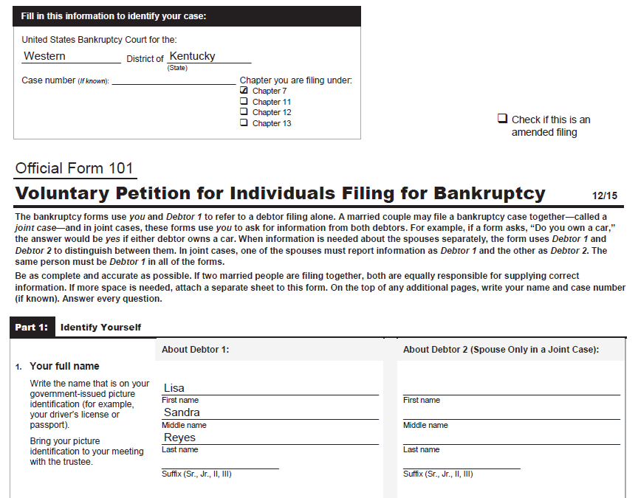
Form 101: Voluntary Petition
Name on government-issued photo ID
If spouses filing jointly, assign one to be Debtor 1 and the other Debtor 2
Notes:
Ask attendees to read the hypothetical for sample case. Module 3 - 3.2

Slide 12
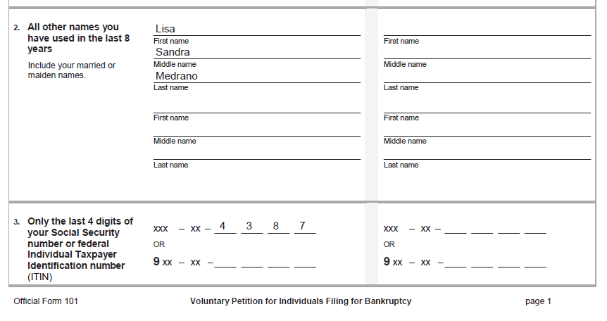
Information about the Debtor
Any other names used in the past 8 years (e.g. maiden name)
Last 4 digits; entire SSN will be provided on Statement of Social Security Number
Notes:
Module 3 - 3.3.1

Slide 13
This question applies to debtors who have operated a business
For DV survivors: Attorney may file a motion to excuse the debtor from providing certain identifying information if it poses an “undue risk of unlawful injury.” See Section 107(c).
Notes:
Module 3 - 3.3.1

Slide 14
Form 101, cont.
Line 6: Why you are choosing this district
This question relates to venue. Most debtors will check box that have lived in district for greater part of past 180 days before filing. If not, debtor would check “I have another reason” and provide explanation.
Line 8: Filing fee. Will the debtor:
Pay the fee upon filing,
$335 for chapter 7
$310 for chapter 13
Pay in installments (either chapter) – must file Form 103A, or
Seek a waiver of the fee (ch 7 only) – must file Form 103B
Notes:
Module 3 - 3.3.1

Slide 15
Any prior bankruptcy cases in the past 8 years. Prior bankruptcy cases may, in some situations:
-Preclude filing the case
-Impact the automatic stay
-Impact availability of a discharge
Renter?
If so, has the landlord obtained a judgment of possession?
If so, must file Form 101A certifying (1) right to cure under nonbankruptcy law, and (2) debtor has deposited with the clerk next 30 days’ rent
Notes:
Module 3 - 3.3.3

Slide 16
Form 101, Part 5: Credit Counseling
Certification of compliance with credit counseling requirement under section 109(h)
Debtor (both Debtors in a joint case) must certify:
completed counseling, certificate attached, OR
completed counseling, will file certificate within 14 days, OR
seeking temporary waiver based on exigent circumstances and being unable to obtain counseling within 7 days of request,* OR
seeking permanent waiver based on incapacity, disability, or military service*
* waiver very difficult to obtain, see Module 2
Notes:
Module 3 - 3.3.3
Remind attendees that if a waiver of the counseling requirement is denied, the case will be dismissed.

Slide 17
Form 101, Part 6
Primarily consumer debts?
definition of “consumer debts” in § 101(8)
if not, the means test will not apply
Prediction as to whether funds will be available for unsecured creditors?
if it is a “no asset” case, notice to creditors will indicate that creditors need not file a proof of claim unless further notice is provided
Notes:
Module 3 - 3.3.3

Slide 18
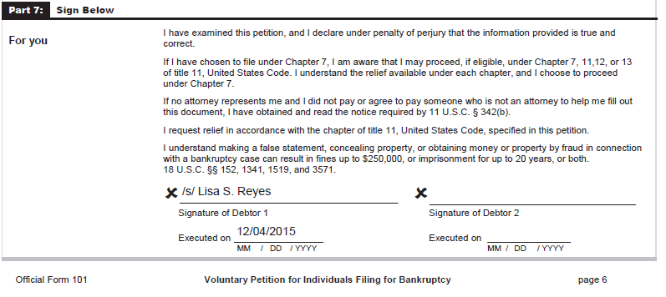
*Remind Debtor that she is signing under penalty of perjury;
*Ask Debtor to look for any errors or omissions; ask if anything has changed since last meeting
*If E-filing, attorney should retain the original petition signed by the Debtor to show that the Debtor authorized the filing (local rules in most districts require this to be maintained for a set period of time)
Notes:
Module 3 - 3.3.4

Slide 19
Form 101: Attorney’s Signature
Certifying that you informed the Debtor regarding eligibility to file under chapter 7, 11, 12, or 13 and explained the relief available under each chapter
Certifying that you gave the Debtor the notice required by §342(b)
form explains the different chapters, bankruptcy crimes
should be provided to the Debtor before signing Petition and schedules
Certifying no knowledge, after an inquiry, that any information contained in the schedules is incorrect (ch. 7)
Notes:
Module 3 - 3.3.4

Slide 20
Form 103A: Application to Pay Filing Fee in Installments
Typically the first installment is paid with the filing of the petition, although not required
Debtor should specify whether first installment will be made with the filing or at a specified date
May be denied if Debtor owes unpaid filing fee from a prior filing
Fee may be paid in up to 4 installments, over no more than 120 days (court may extend to 180 days for cause)
Notes:
Module 3 - 3.5; Bankruptcy Rule 1006(h)
Discuss any local court preferences regarding installment payments

Slide 21
Form 103B: Application to Waive Chapter 7 Filing Fee
Income must be below 150% of the federal poverty line
Family size: include all dependents listed on Schedule J; include non-filing spouse unless separated
Income: average monthly net income listed on Line 10 of Schedule I, less any non-cash government assistance
Ms. Reyes has deducted her SNAP and child care assistance
If filing Schedules A/B and J at the same time, you may omit information about expenses and assets on 103B
Explain any special circumstances (e.g., Earned Income Tax Credit will be needed to make car repairs)
Notes:
Module 3 - 3.6

Slide 22
Form 121: Statement of SSN
*Submitted to the Court, not part of the public file (to protect the Debtor’s secure information)
*Both Debtors must complete in a joint case
*Must include all SSNs the Debtor has (for example, if a second SSN was assigned due to identity theft)
*List any ITIN (if the Debtor has one – because not eligible for a SSN)
Notes:
Module 3 - 3.4

Slide 23
Mailing List
Also known as the “mailing matrix” or “creditor matrix” – not an Official Form
Must list names and addresses of all creditors on Schedule D and E/F and any entity included on Schedules G and H
Check local rules for format
may need to provide as a .txt file
may need to include the IRS or state tax authorities
Notes:
Module 3 - 3.7

Slide 24
Mailing List
Anne Gordon, M.D.
145 N. Central Ave.
Louisville, KY 40203
AS & S Communications
P.O. Box 4466
Lone Tree, CO 80124
BankCard Choice
222 Credit Card Lane
Wilmington, DE 19899
Blackstone Rental Properties, Inc.
444 Commerce Way
Lexington, KY 40506
BuyHereNow Auto Sales, Inc.
234 Executive Park
Louisville, KY 40203

Slide 25
Schedule A/B: Property
List of the Debtor’s real and personal property
Real property:
Where is it? Street address or lot number
Current value of the entire property and the Debtor’s interest – e.g., if debtor owns a ½ interest and her brother owns the other ½
List the full value without deducting exemptions or secured claims
Sources for value: appraisal, BPO, tax valuation, online tool
If there is a wide range in the value, Debtor should get an appraisal before filing the case
Nature of interest: fee simple, life estate, equitable interest under a land installment contract (these also go on Schedule G)
Notes:
Module 3 - 3.9.1

Slide 26
Schedule A/B: Property
Personal property:
Vehicles
List all vehicles the Debtor owns, registered or not, even if someone else is driving them
If car has been repossessed, still list here if Debtor retains any interest
Make, model, year, approx. mileage, any other relevant info (inoperable, needs significant repairs)
Valuation: best estimate of fair market value. May use an online industry guide (NADA or Kelley Blue Book)
Notes:
Module 3 - 3.9.2

Slide 27
Schedule A/B: Property
Personal and household items
Separately list each major appliance or item of significant value (worth more than $500)
Descriptions are helpful to support valuation (age, condition)
Can include a catch-all for miscellaneous items (“assorted dishes and cookware,” or “casual clothes”); specify “no item worth more than $600” to comply with fed exemptions (or other limit in state exemptions)
Est. value of each item: garage sale value
Notes:
Federal exemptions allow the Debtor to exempt up to $12,625 in aggregate value in household goods and furnishings, no more than $600 in any particular item.
Explain if state exemption scheme has a similar limitation

Slide 28
Schedule A/B: Property
Catch-all
Garage sale value
Description (age)
Notes:
Module 3 - 3.9.3

Slide 29
Schedule A/B: Property
Other personal property
Line 17, Deposits of money: balance as of the petition date
Line 20, Retirement or pension accounts: if the pension plan is ERISA-qualified, indicate “not part of the bankruptcy estate”
Line 28, Tax refund – estimated, prorated
Line 29, Family support – past due or lump sum amounts; indicate if not likely collectible
Notes:
Module 3 - 3.9.3

Slide 30
Schedule A/B: Property
Notes:
Module 3 - 3.9.5

Slide 31
Schedule A/B: Property
Line 33, Claims against third parties
potential causes of action
estimated value should consider likelihood of success and probability of collecting
Line 34, Other contingent and unliquidated claims
avoidance claims – to recover garnished wages being held by an employer (§ 547)
Notes:
Module 3 - 3.9.5

Slide 32
Schedule A/B: Property
Notes:
Module 3 - 3.9.5

Slide 33
Schedule C: Exemptions
Goal is to exempt as much of the Debtor’s property as possible – hopefully all
Check against Schedule A/B to make sure nothing is omitted, same market value for items
Claim as exempt any property that was taken and may be recovered (foreclosed home during a redemption period; garnished wages)
Claimed exemptions are deemed allowed unless a party in interest objects within allowed time. See Bankruptcy Rule 4003, Module 1.
Notes:
Module 3 - 3.10

Slide 34
*Select state or federal exemptions
*If state has opted out of the federal scheme, must use state exemptions.
*Joint debtors must elect the same set of exemptions.
Notes:
Module 3 - 3.10

Slide 35
Schedule C
Full fair market value of the debtor’s interest in the property (without deducting liens or exemptions)
Amount of claimed exemption: generally should correspond to the Debtor’s equity in the property.
*May be wise to claim the full amount of a dollar-capped exemption, in the event liens may be avoided
or property is worth more.
*If Debtor owns no equity in a home, may still claim an exemption based on possessory interest.
Relevant code section (source of the exemption)
Notes:
Module 3 - 3.10
Debtors who do not have equity in their home may still claim a homestead exemption based on their possessory and legal ownership interest in the property. See Owen v. Owen, 500 U.S. 305 (1991).

Slide 36
Schedule C
Use this language to indicate intent to exempt the entire asset, where the value of the asset is uncertain because it is contingent and unliquidated. See Schwab v. Reilly, 130 S.Ct. 2652 (2010).
*If the exemption has a dollar cap, checking this box allows the Debtor to claim the full fair market value up to any applicable statutory limit.
Notes:
Module 3 - 3.10

Slide 37
Schedule C
Wild-card exemption:
A “floating” exemption that can be used for any property – cash, tax refunds, garnished funds, security deposits, potential causes of action, etc.
Federal wild card: $1,250 plus up to an additional $11,850 of unused homestead exemption= $13,100 max (per Debtor) under§ 522(d)(5); many state exemption schemes have a wild-card exemption as well
May be “stacked” with other exemptions; for example, if you have a washer worth $800, and can only claim up to $600 in any individual item under the household goods & furnishings exemption, the remaining $200 can be claimed under the wild-card exemption
Notes:
Module 3 - 3.10

Slide 38
Schedules D and E/F: Listing Creditors
It is VERY IMPORTANT to list the correct name and address of every creditor or potential creditor.
If a creditor fails to receive notice, their debt may not be discharged
Other information – last four digits of account number, amount owed, date incurred – is less important; provide best estimate in good faith
If a debt shows up on credit report and Debtor doesn’t recognize it, list it and check “disputed”
If a debt has been sold or transferred to a collector, list previous creditors and debt collectors as “others to be notified” in Part 2 of Sched. D or Part 3 of Sched. E/F (ensure that all parties get notice!)
Notes:
Module 3 - 3.11

Slide 39
Schedules D and E/F: Listing Creditors
Contingent, unliquidated, and disputed claims
Contingent: liability not firmly established; e.g., if Debtor is a guarantor and the primary obligor has not yet defaulted.
Unliquidated: liability exists but the amount owed is uncertain; e.g., debtor has been found liable for negligence, but damages not yet determined.
Disputed: Debtor disputes either liability on the debt or the amount owed; e.g., debt claimed by a party the Debtor does not recognize – may or may not own it
Notes:
Module 3 - 3.11

Slide 40
Last 4 digits only, to protect against ID theft
Very important to list the correct creditor address; do a diligent search; when in doubt, list other possible addresses as additional notification
Amount owed (Best estimate; actual amount creditor will be paid is determined based on proof of claim)
On a credit card: date account was opened, range of dates, or “various dates”
Check “disputed” if the Debtor is unsure about liability, amount of the debt, or identity of the creditor
Notes:
Module 3 - 3.11; 3.12

Slide 41
Schedule D: Secured Claims
List here all creditors that hold liens, even if liens can be avoided:
Mortgages
Judgment liens
Garnishments
Creditors holding a security deposit
Tax lien holders
Banks that have a right of setoff against account
Rent-to-own contract if debtor intends to treat as a secured claim
Notes:
Module 3 - 3.12

Slide 42
Schedule D
Full amount owed, even if it exceeds the value of the collateral
Amount of the claim minus value of the collateral. Do not list on Sched. E/F
Full fair market value; should correspond to Schedule A/B
Notes:
Module 3 - 3.12

Slide 43
Schedule E/F: Priority and Unsecured Claims
Part 1: Priority claims under § 507
Tax debts
not all tax debts are priority; check § 507(a)(7)
if the tax creditor holds a lien, then it is secured, not priority!
Domestic support obligations
Sometimes only a portion of the creditor’s total claim is entitled to priority – list both the priority and nonpriority portions in Part 1
Notes:
Module 3 - 3.12.1

Slide 44
Schedule E/F
Amount entitled to priority under 507(a)
Nonpriority amount goes here, not in Part 2

Slide 45
Schedule E/F, Part 2: Nonpriority Unsecured Claims
List all debts – even ones that have been “charged off”
this is an accounting term, does not mean liability is eliminated
If Debtor does not think the debt is owed, disputes the amount, or thinks it is past the statute of limitations, check “disputed”
Notes:
Module 3 - 3.12.2

Slide 46
Schedule E/F, Part 2
Utility debts: unless a current bill has just been paid and no balance is owed, should be listed (even if not in debtor’s name)
Payday loans (are not secured, as they may argue)
Executory contracts and leases, if terminated pre-petition, should be listed here
Notes:
Module 3 - 3.12.2

Slide 47
Schedule G: Executory Contracts and Unexpired Leases
Residential leases: list even if just month-to-month, oral agreement
Automobile leases (Ch. 7 Debtor must declare intention with respect to the lease on Statement of Intention, Form 108)
Rent-to-own contracts – unless Debtor elects to treat as a secured claim on Sched. D
Notes:
Module 3 - 3.13

Slide 48
Schedule H: Codebtors
Any codebtors, other than a spouse in a joint case
If Debtor has lived in a community property state in the past 8 years, must list the state and provide name and address of any spouse during that time
Former spouse who is jointly responsible for providing food and medical care for dependents should be listed
Guarantor on a debt owed by the debtor
Notes:
Module 3 - 3.14

Slide 49
Schedules I and J: Income and Expenses
In chapter 7 case, Schedules I and J help the court determine if the filing is an “abuse” of the bankruptcy system and subject to dismissal under § 707(b)
In a chapter 13 case, Schedules I and J allow the trustee and creditors to determine if the chapter 13 plan is feasible and complies with plan requirements
Notes:
Module 3 - 3.15

Slide 50
Schedule I: Debtor’s Income
Include the income for both spouses in a joint case and when one spouse files individually, unless the spouses are separated
Average monthly income as of the date the form is filled out
Include seasonal, part-time, and self-employed work
Notes:
Module 3 - 3.15.1

Slide 51
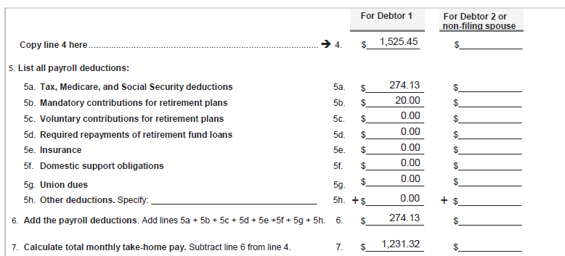
Include income of non-filing spouse unless separated
If the Debtor has more than one employer, combine the information for all employers on each line.
Notes:
Module 3 - 3.15.1

Slide 52
Debtor should list net income from operating a business on line 8a, and attach a statement showing gross receipts, business expenses, and net income
Child support or alimony goes on line 8c; regular contributions to expenses from someone not a spouse (such as an unmarried partner, roommate, or dependent) go on line 11.
Notes:
Module 3 - 3.15.1

Slide 53
Schedule J: Expenses
Do not list names of minor children; only relationship to the Debtor and age
(§ 112, Bankr. Rule 9037)
Notes:
Module 3 - 3.15.2

Slide 54
Schedule J: Expenses
List expenses of both Debtors in joint case, Debtor and non-filing spouse in individual case
If joint case but Debtors keep separate households, report expenses for Debtor 2 on Schedule J-2
Schedule J should reflect ongoing average monthly expenses
For expenses that occur less often, include monthly average (e.g., average home maintenance cost over the year, divided by 12 months)
List total expense, including amounts covered by public benefits (Ms. Reyes listed total spent on food, include amounts paid with SNAP benefits)
Notes:
Module 3 - 3.15.2

Slide 55
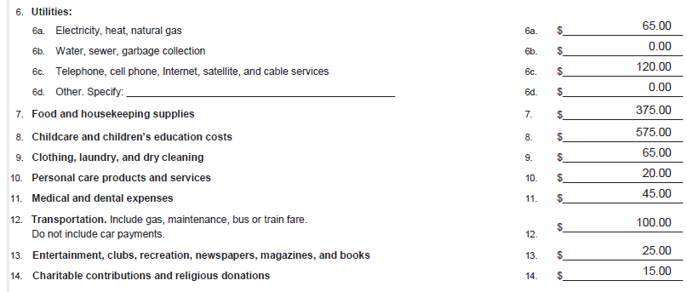
Report the average utility payments (gas will be highest in winter, electricity highest in summer)
Food cost is difficult to estimate. Ask, “How often do you buy groceries? And how much do you typically spend?”
Include cleaning supplies. Then add in cost of school lunches for kids, meals out (frequency x cost)
Diapers and toiletries go on line 10

Slide 56
Schedule J
Do not include portion of a bill paid by a roommate or unmarried partner unless you are also including their contribution on Schedule I
Remember to note expected changes in income or expenses on Sched. I and J
Notes:
Module 3 - 3.15.2

Slide 57
Form 106Sum: Summary of Schedules
*Summarizes information from the schedules
*Used for statistical reports that the courts are required to make public
*Automatically compiled if you are using software
Notes:
Module 3 - 3.16

Slide 58
Form 106Dec: Debtor’s Declaration
Ask the Debtor to sign the declaration after reviewing the schedules together
Remind Debtor that she is declaring under penalty of perjury that she has read the forms and all information is correct
Notes:
Module 3 - 3.17

Slide 59
Form 107: Statement of Financial Affairs (SOFA)
This form contains detailed questions about the Debtor’s financial circumstances, covering different time periods – read each question carefully!
Spouses filing jointly may file a single Statement, but must include all information for both spouses
In cases under chapter 12 or 13, a married debtor filing individually must include spouse’s info (unless separated)
Notes:
Module 3 - 3.18

Slide 60
Form 107: SOFA
Part 2: Past income
Covering the current calendar year (YTD) and the two calendar years immediately preceding
Question 4: income from employment or operation of a business
Report gross income
Question 5: income other than from employment or operation of a business
Includes Social Security benefits, public assistance, unemployment benefits, tax credits, alimony, pensions, etc
Notes:
Module 3 - 3.18

Slide 61
Form 107: SOFA
Part 3: Payments made before filing bankruptcy
If debts are not primarily consumer debts: During the 90 days before filing, did you pay any creditor $6,425 or more?
If debts are primarily consumer debts: During the 90 days before filing, did you pay any creditor $600 or more?
Not limited to voluntary payments – Ms. Reyes listed her garnishment
Question 7 and 8: payments to creditors who are “insiders” (or for their benefit) within the year before filing.
Insiders include relatives and some business relations.
Notes:
Module 3 - 3.18

Slide 62
Form 107: SOFA
Part 4: Legal Actions, Repossessions, Foreclosures
Lawsuits to which the debtor was a party in the past year; if debtor was the plaintiff, should also be listed on Schedule A/B (assets) and exempted on Schedule C
Repossessions, foreclosures, garnishment, etc within the past year
may still be property of the estate if Debtor retains an interest
Setoffs within past 90 days – may apply if the Debtor has a credit account with the same bank where she has her bank account
Receiver, custodian, etc within the past year – usually N/A
Notes:
Module 3 - 3.18

Slide 63
Form 107: SOFA
Part 5: Gifts and contributions
list any recipient to which the Debtor gave more than $600 in the past 2 years
Debtor’s Church is a common one
Part 6: Losses from fire, theft or gambling
insurance proceeds should be listed on Schedule A/B and exempted on Schedule C, if possible
Notes:
Module 3 - 3.18

Slide 64
Form 107: SOFA
Part 7: Certain payments and transfers
Payments for bankruptcy-related services in past year, such as credit counseling course (if a fee was paid)
Payments to debt consolidation companies in past year
Any transfer in past 2 years made outside of normal course of business
granting a mortgage on the Debtor’s home
transferring or selling a car to another person
repossession of a car (if not already listed, because more than 1 year ago)
Any transfer to a self-settled trust in past 10 years
Notes:
Module 3 - 3.18

Slide 65
Form 107: SOFA
Part 8: Financial accounts, etc
any financial accounts closed in past year
Part 9: Property you hold for someone else
Part 10: Has the Debtor been notified of any environmental hazard or liability posed by her property?
Part 11: Has the Debtor been in business in the past 4 years?
Notes:
Module 3 - 3.18

Slide 66
Form 108: Statement of Intention
Only required in chapter 7 cases; Debtor must indicate intent with regard to collateral securing a claim and any leases of personal property
Must be filed within 30 days of filing the petition or on or before meeting of creditors, whichever is earlier
Must be served on secured creditors and lessors listed on the form
Debtor must carry out the stated intention within 30 days after the meeting of creditors (45 days for personal property secured by a PMSI)
Notes:
Module 3 - 3.19

Slide 67
Form 108: Statement of Intention
Are there more than 3 options?
Most courts now require the Debtor to either surrender, redeem, or reaffirm. This 4th option, retain and keep paying, was recognized by many courts until the 2005 bankruptcy amendments – and is still an option for home mortgages (See § 524(j)).
Reaffirmation may not be wise; consider alternatives (See Module 4)
Option to retain and pay may depend on local practice and individual creditors.
Notes:
Module 3 - 3.19

Slide 68
Form 122: Means Test Forms
122A-1 and 122A-2 are used in chapter 7 cases
122C-1 and 122C-2 are used in chapter 13 cases
Debtors who do not have primarily consumer debts or are otherwise exempt from means testing should file Form 122A-1Supp
Income that is a benefit under the Social Security Act is excluded
Include non-filing spouse’s income unless separate households (always include on Form 122C-1)
Notes:
Module 3 - 3.20

Slide 69
Form 122: Means Test Forms
Form 122A-1 and 122C-1 involve the calculation of current monthly income
In general, current monthly income is the Debtor’s average monthly income for the 6 calendar months ending prior to the month of filing
Compare to the median family income for the applicable household size in this state – if Debtor’s income falls below the median, then the safe harbor applies > Debtor need not complete Form 122A-2 or 122C-2
Notes:
Module 3 - 3.20.1

Slide 70
Disclosure of Attorney Compensation
For a pro bono attorney, each of these will be $0.00
Notes:
Module 3 - 3.21

Slide 71
Payment Advices
Section 521(a)(1)(B)(iv) requires Debtor to file payment advices covering the 60 days before filing petition
If Debtor received no payment advices during that time, she need not file anything; but local rule may require a certification to that effect
Some courts have local rule that payment advices should be provided to the Trustee, not filed
If Debtor cannot obtain the payment advices, may file a motion to excuse the filing and provide alternative proof of income during the 60-day period
Notes:
Module 3 - 3.22

